Slide 1
Quantitative Sciences in Drug Development
Clinical Development and Analytics
University of Nebraska-Lincoln (STAT 810)
Eric Gibson, PhD Global Head Analytics
November 25, 2019

Slide 2
Introduction
I graduated from KSU in 1997 with a PhD in statistics (tuition for my last semester was $564 plus $706 for campus fees).
Today I lead a global team of 450 people across nine countries and manage a $100m budget.
My team is a diverse group of quantitative scientists with mixture of different specialties including statistics, pharmacometrics, data science, machine learning, and more.
They are embedded in clinical projects in all phases of development and collaborate with multidisciplinary teams to design and plan programs, drive strategy, and make sound decisions and predictions based on data.

Slide 3
Analytics = diverse quantitative sciences
Early Development Biostatistics
Translational Clinical Oncology
Translational Medicines
Discovery
Development Unit Biostatistics
Oncology
IHD
CM
RESP
NS & Ophtha
Biosimilar
Late Phase Biostatistics
Oncology GMA
Pharma GMA
Global Health
Pharmacometrics
Early Clinical
Development Units & Submissions
Biophysics
Biomarkers & Diagnostics
Advanced Methodology & Data Science
Statistical Methodology
Advanced Exploratory Analytics
Translational Technology
Scientific Computing & Consulting

Slide 4
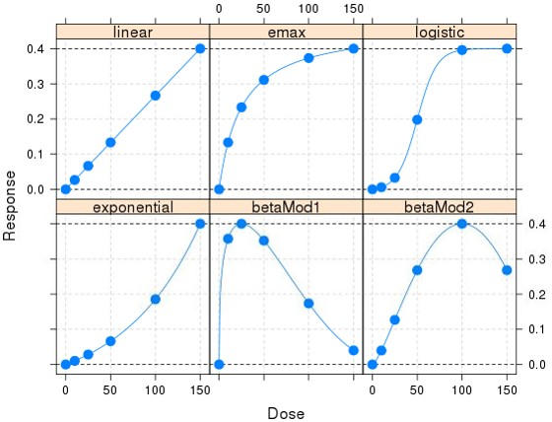
MCP-Mod for Contemporary Dose-Finding
2002
An internal initiative on model-based methods in dose-finding trials.
Scientific and regulatory outreach and via joint research, publications, conferences, committees...
Industry collaboration via training (internal and external), software development, and guidance.
Qualified by EMA (2014)
Fit-for-purpose by FDA (2016)
Used in >20 Novartis Phase II trials
2016

Slide 5
Risk-based Portfolio decision making
Should we invest in third phase 3 study?
Phase 2b results (visual acuity)
Significant treatment effect of 3.71 letters
Clinically meaningful = at least 4 letters
Probability of Success (in phase 3 given phase 2)
P(clinically meaningful result in Phase 3) ≈ 20%
P(significant effect in phase 3) ≈ 50%
Revised PoS (2 completed Phase 3 studies)
P(clinically meaningful result in Phase 3) ≈ 3%
P(significant effect in a 3rd Phase 3) ≈ 14%

Slide 6
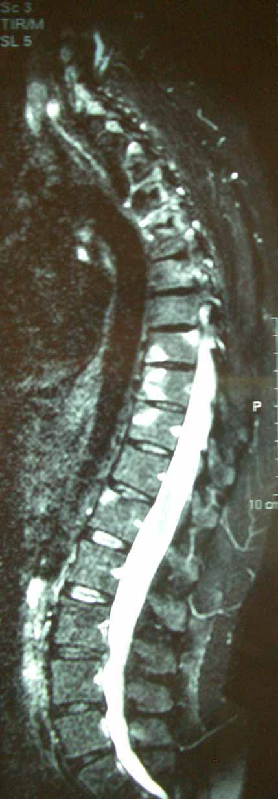
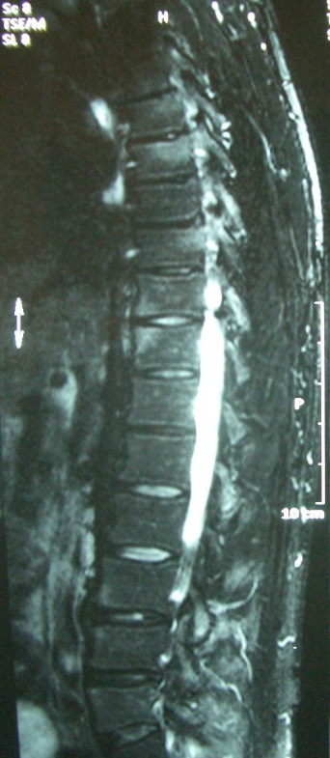
Big data and data science
5-year collaboration
2 projects
between Novartis and Oxford’s Big Data Institute
The statistician plays a critical and central role in working with data wrangling, machine learning, computing, imaging, genomic, clinical, and medical experts.
+
1
→
2
1
Clinical and MRI data from 35,000 multiple sclerosis patients
Dermatology and rheumatology data in >11,000 patients

Slide 7
Statistical leadership is the key ingredient
Scientists are generating data more rapidly than ever, driving the increasing need for statistical skills.
They are thirsty for input from statisticians, and yet we are not engaging and speaking up in the way we should.
While we see ourselves as “stewards of sound thinking for good decision-making,” our stakeholders too often sees us as number crunchers.
https://amstat.tandfonline.com/doi/full/10.1080/00031305.2017.1336484

Slide 8
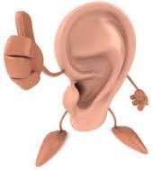
Core competencies of statistical leadership
Listen
Learn the language of the science.
Patience, and the persistence to ask the right questions.
Identify what is important to the problem or design.
Network
Proactively develop relationships.
Understand the team dynamics, and respect your colleagues.
Meet regularly with team members.
Speak up
Share your ideas in real time.
Prepare your thoughts and ideas.
Strive for simplicity, and adapt to your audience.

Slide 9
Influence...
Is a process - not an event.
Recognize that the multidisciplinary team is seeking a clear recommendation from you, so try to avoid ambiguous statements.
This may be simply that “there isn‘t enough data for a clear determination.”
When two or more statisticians are on the team together, or handing off from one to another, they should align in advance.
Use judgment in determining when to press further, and take care not to react with a negative attitude – even unintentionally.

Slide 10
Thank you for your attention
Any Questions?

