Slide 1
Life as a Data Scientist
Jessica Burow
October 28th, 2019

Slide 2
Outline
Looking inside the role of a Data Scientist
How the University of Nebraska has aided in my career growth
What I wish I would have learned in school
Current and diverse opportunities for statisticians
Tips for the journey

Slide 3
Looking Inside the Role of a Data Scientist

Slide 4
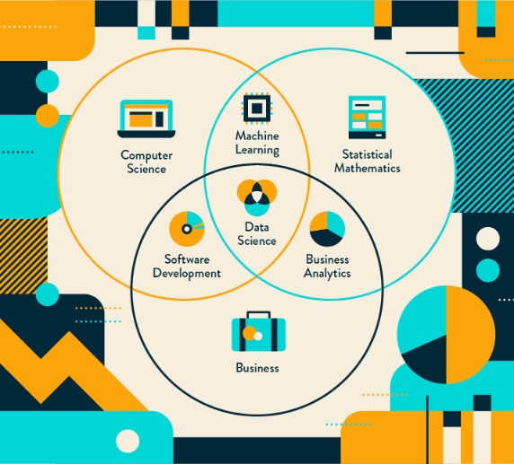
What is Data Science?
Notes:
https://clevertap.com/blog/data-science/

Slide 5
My Work Experience Since Graduation
Employed by The Hartford Insurance Company
Data Science Summer Intern - 2015
Associate Data Scientist - August 2016
Data Scientist - March 2018
Worked on the following teams
Small Commercial (SC) Data Science:
Underwriting
Property & Liability
Claims Data Science

Slide 6
High Level Overview of my Job at The Hartford
Insurance Business
SC Underwriting
Predicting loss ratio of long term customer
SC Property & Liability Coverages
Building, Contents, Premises & Operations, Business Interruption, etc.
Predicting frequency and severity of loss
Claims (Personal and Commercial Lines)
Auto, Property, Workers Compensation, Group Benefits
Modeling
Linear Regression:
Generalized Linear (Mixed) Models
Regularization:
Least Absolute Shrinkage and Selection Operator (LASSO)
Ridge Regression
Elastic Net
Ensemble:
Random Forest
Gradient Boosting Machine
Project Work
Testing Third Party Data (3PD)
Application Enhancement
Class Plan Ratemaking
Model Maintenance
Data
Small Commercial Property & Liability
Policyholder level data
Up-to 30+ million rows/1,000 columns

Slide 7
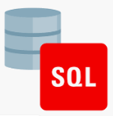
Tool Box
Programming
R
Web applications with Shiny
Rmarkdown
Python
SQL
SAS
Data Storage
Oracle – Relational Data Warehouse
Hadoop – Distributed Storage and Processing of Big Data
Scalable machine learning with H2O
Cloud Computing with Amazon Web Services (AWS)
Distributed Version Control with GitHub

Slide 8
Looking Inside the Role of a Data Scientist
Testing Third Party Data (3PD) from Vendors

Slide 9
Types of 3PD from Vendors
Financial data derived from IRS tax returns, the U.S. Census and Department of Labor
Data aggregated at zip code and industry level, such as profit, dividends, etc.
Test 3PD value against internal models
Predicting frequency of claims
Coverage for small commercial premises/operations and contents
Property & liability underwriting reviews
Data such as construction type, age of building, etc.
Test 3PD value against internal models
Predicting frequency and severity of claims
Coverage for small commercial building, contents, and business interruption

Slide 10
Process of Testing 3PD Against Internal Models
Data Processing:
Join 3PD to internal data, profile variables and hit rates, view one-way cuts
Handle null values, convert to factor/numeric, split on train/test/validation
Modeling
Grid search hyper-parameter tuning and fitting best LASSO, Elastic Net, Ridge Regression, Random Forest, Gradient Boosting Machines with lowest RMSE
Analysis
Identify variables that have the most predictive power and the highest impact on the outcome that are well represented in the best fit models
Test these top variables against the internal model to see if they are significant, improve predictive accuracy, increase the GINI metric and provide lift

Slide 11
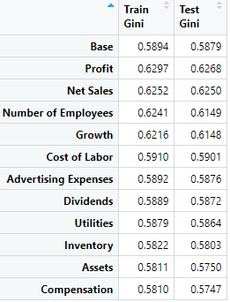
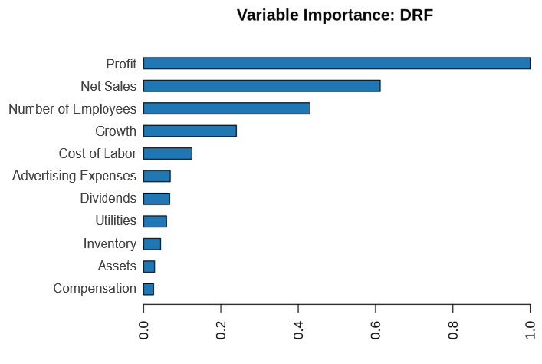
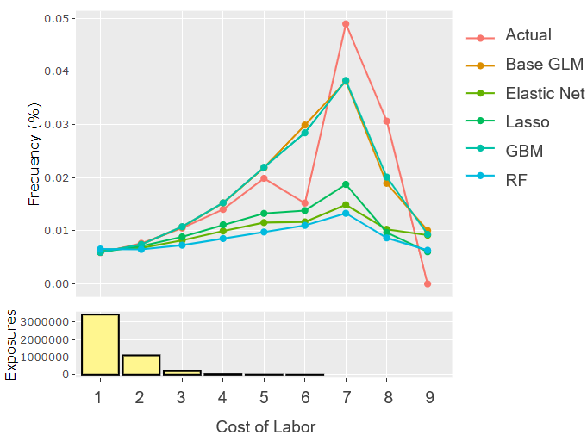
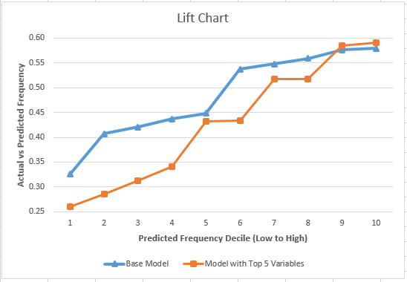
Various Metrics Used to Assess Performance
2.
Variable Importance
GINI
P-Values
Model Actual vs Predicted
Lift Chart
1.
3.
4.
5.
Note: These are not actual results from The Hartford, but fabricated for example purposes only.

Slide 12
Looking Inside the Role of a Data Scientist
Application Enhancement

Slide 13
Shiny Application Work Load
Prior colleague built Shiny application in R
Tool designed for: Product Managers and Territory Analysts
Purpose of tool: interactively visualize the indicated property and liability risk by state and coverage at a zip and territory level.
My work focused on enhancing the tool
Updated and analyzed the data
Analyze the potential power still in the residuals
Added/removed heat map features
Incorporated a guided tour

Slide 14
Design of Tool
Tool is designed with tabs to:
Upload State by Coverage (Contents, Building, PremOps, Business Interruption)
View actual vs class plan predicted loss, geography factors, and residuals by territory
Make territory selections and view heat map factors by peril (tornado, hail, hurricane)
Output data on zip and territory level
County, city, quotes, yield, exposures and factors
View heat maps of geography factors such as
Population density and other Census information

Slide 15
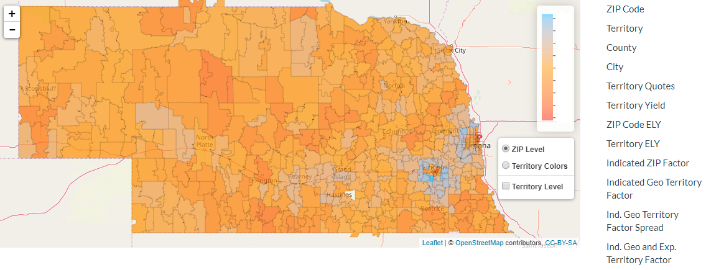
Heat Map Used for Making Territory Selections of Nebraska
Low factor
High factor
Group territories according to risk of loss.

Slide 16
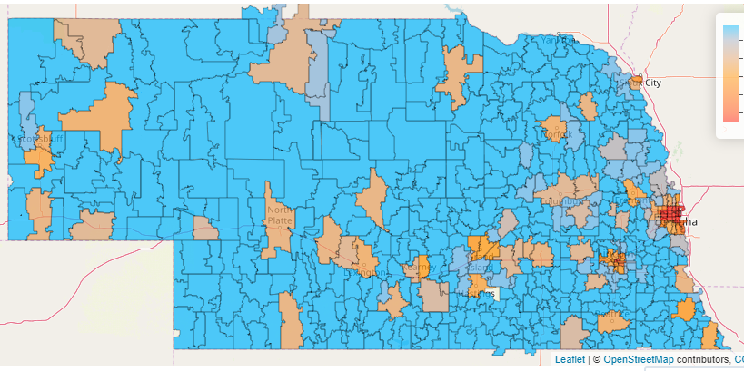
Heat Map of Geography Factors: Frequency of Loss Relative to Population Density in Nebraska
Low factor
High factor
Higher frequency of loss where the population is dense.

Slide 17
How the University of Nebraska has Aided me in my Career Growth
Graduate school was a lesson in having patience for delayed rewards
Self-teaching and utilizing “Google University”
Establishing a community to share ideas and support
Finding balance with the 15-15-15 rule
Understanding the foundational concepts of Statistics, how to properly build a model, interpret the results, and to communicate them in layman’s terms.
Learning R and SAS
Teaching Undergraduates gave me courage to speak in front of business partners and developed my presentation skills

Slide 18
What I Wish I Would Have Learned in School
More robust data handling and preparation, millions of rows and hundreds of columns of data
Greater proficiency in programming to develop applications for our internal business partners, including automated model testing or creating a tool for heat maps in Shiny, etc.
Broader horizons in cutting-edge technology
Concepts such as Artificial Intelligence, Neural Network Analysis, Natural Language Processing, Tree-Based Methods
Tools such as GitHub, the Cloud, Hadoop, Spark, Python, etc.

Slide 19
Current and Diverse Opportunities for Statisticians
Plenty!
Where there is data, Statisticians will be of value
According to the Bureau of Labor Statistics, the Job Outlook for Statisticians from 2018-28 is 30%.
We are in an age of booming data across all sectors, within corporate, academia, government, etc.
The companies and organizations that will stay afloat are the ones that extract key insights from data to improve their processes.
Notes:
https://www.bls.gov/ooh/math/mathematicians-and-statisticians.htm

Slide 20
Current and Diverse Opportunities for Statisticians
Public Service
Presidential Campaign
Census Bureau
Human Rights
Crime
Health & Wellness
Clinical Trials
Animal Health
Environment & Science
Marine Life
Biostatistics
Agriculture
Technology
Cloud-computing
Internet Search Engine
Software development and testing
Social Media
Other Industries
Sports
Economics & Finance
Industrial Manufacturing
Education
Journalism
Notes:
ASA - https://thisisstatistics.org/jobs-in-statistics/

Slide 21
Tips for the journey
Build a network of peers to lean on and grow with during grad school.
Be patient – solving problems in grad school is like sucking on a giant jaw breaker… it could take all day and multiple sheets of paper to solve ONE problem… and when you’ve reached the end of your rope, tie a knot and hang on.
Don’t hesitate to ask questions. And even after grad school you must always be continually learning and developing new skills to stay relevant.
Take courses outside of the Statistics department to learn about interdisciplinary work or enhance your programming and data skills.
Expand your horizons and travel across the country or abroad for an internship... The best time to start applying is October.
Notes:
https://www.pinterest.com/pin/503629170812126411/
https://courses.lumenlearning.com/boundless-management/chapter/defining-teams-and-teamwork/

Slide 22
Questions
Notes:
https://www.skipprichard.com/ask-questions-to-improve-your-leadership/

Slide 23
References
The Hartford Financial Services Group, Inc.
https://clevertap.com/blog/data-science/ (slide 4)
https://www.bls.gov/ooh/math/mathematicians-and-statisticians.htm (slide 19)
https://thisisstatistics.org/jobs-in-statistics/ (slide 20)
https://www.pinterest.com/pin/503629170812126411/ (slide 21)
https://courses.lumenlearning.com/boundless-management/chapter/defining-teams-and-teamwork/ (slide 21)
https://www.skipprichard.com/ask-questions-to-improve-your-leadership/ (slide 22)

