Slide 1

Insights from former UNL graduate student to current Biostatistician at Novartis Oncology
Michelle Quinlan, PhD
Associate Director of Biostatistics
Novartis Oncology, East Hanover, NJ

Slide 2
Outline
Background
Life as a Biostatistician at Novartis Oncology
Clinical Pharmacology (CP) Biostats at Novartis Oncology
General advice for graduate students
UNL experiences which were helpful
Questions?

Slide 3
Background
2005: BA from Concordia University
(major Math/Business, minor Actuarial Science)
2007: MS in Statistics from UNL
2010: PhD in Statistics from UNL (dissertation on shelf life estimation)
2010-present: Clinical Pharmacology Biostatistician at Novartis Oncology

Slide 4
Life as a Biostatistician at Novartis Oncology

Slide 5
Novartis Oncology
Background
Global headquarters: Basel, Switzerland
US headquarters: East Hanover, NJ
Other locations
  Hyderabad, India
  Paris, France
  Tokyo, Japan
Impacting cancer patients one drug at a time

Slide 6
Role of biostatistician at Novartis Oncology
Member of clinical trial team
Responsibilities as member of cross functional clinical trial team include:
  Providing input to clinical trial protocols & case report forms (data collection)
  Creating statistical analysis plans
  Working with programmers to create outputs for clinical study report (CSR)
  Writing statistical results in CSR
Life as a Biostatistician

Slide 7
Role of biostatistician at Novartis Oncology
Member of submission team
Responsibilities as member of team preparing documentation for submission to health authorities (HA) include:
  Creating statistical analysis plans to address clinical pharmacology, safety, and efficacy aspects of drug
  Preparing datasets for submission to FDA
  Answering ad hoc HA questions

Slide 8
Role of biostatistician at Novartis Oncology
Member of exposure-response team
Responsibilities as member of exposure-response team to establish correct dose for further development:
  Working with clinical pharmacologists and clinicians to utilize data to make inference on recommended dose
  Addressing questions such as:
    Does increasing exposure increase probability of adverse events?
    Does increasing exposure increase efficacy?
    What is the optimal dose (maximum efficacy, minimum side effects)

Slide 9
Now a glimpse into Clinical Pharmacology (CP) Biostatistics at Novartis Oncology...

Slide 10
Intro to clinical pharmacology (CP) studies
CP studies form basis of early drug development work & remain important component of late stage development
Aims of CP studies include:
  To assess how much drug in the body at a given dose (at a given time)
  To determine dosing strategy (single/repeat dose, IV/oral)
  To link drug concentration to pharmacodynamics (efficacy and safety)
Typically done in healthy volunteers if possible

Slide 11
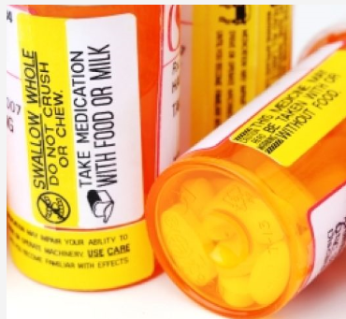
Types of CP studies
Examples
Different objectives corresponding to different types of CP studies, e.g.
  ADME - Organ impairment (renal/hepatic)
  Bioequivalence - Thorough QT
  Bioavailability - Drug-drug interaction
  Food effect - Ethnic sensitivity
→ These studies are used to obtain information
that will go onto drug label and package inserts

Slide 12
Bioequivalence studies
Formally demonstrate two formulations have similar bioavailability
  e.g. rate (Cmax) and extent (AUC) of absorption are the same for Tablet vs. Capsule

Slide 13
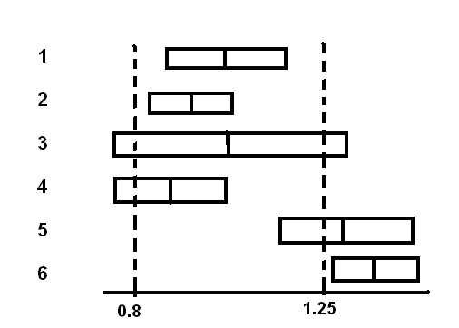
Bioequivalence studies
Statistical analysis involves computing geometric mean ratio and 90% CI for ratio of PK parameters from e.g. Tablet vs. Capsule and comparing results to 0.80-1.25 bounds
  Six example scenarios, do they meet bioequlvalence criteria?
Answers:
1, 2: yes
3: no (could have passed with >N)
4: failed (likely formulation effect,
could have passed with >N)
5, 6: no (completely different)

Slide 14
Other CP studies
Food effect, Organ impairment
Food effect
  Statistical analysis involves computing geometric mean ratio and 90% CI of PK parameters from fed state (high fat or low fat meal) vs. fasted state
  Ratios <<1 or >>1 indicate negative or positive food effect
Organ impariment
  Most drugs are eliminated either through renal or hepatic excretion; many are metabolized in liver and excreted renally
  Decreased clearance of drug by impaired liver/kidney
    →Increased Cmax & likelihood of adverse events associated with exposure
    →Potential dose reduction in patients with impaired hepatic/renal function

Slide 15
Other CP studies
Drug-Drug Interaction
Drug-drug interaction
  Metabolic elimination can be inhibited, activated, or induced by concomitant drugs
  Investigational drug may inhibit/induce metabolism of other compounds
Goals of DDI study
  Compare geometric mean ratio of PK parameters of drug with & without interacting drug
  Determine if interaction necessitates dose adjustment or contraindication on label

Slide 16
General advice
&
Helpful UNL experiences/courses

Slide 17
General advice for graduate students
Establish contacts with professors and people in areas you wish to work
Pursue research/teaching assistantships to cover costs of school
Seek out internships; first hand experience goes a long way
Research potential jobs/areas of statistics online
Masters is helpful but some industries (e.g. pharmaceutical) require PhD; PhD makes you more marketable
The more you put into your education the more you will get out of it!

Slide 18
Helpful UNL experiences/courses
Research assistantship with PQRI Stability Shelf Life Working Group; allowed interaction with members of pharma industry
Attending conferences
Working with classmates on challenging homework problems
Weekly seminars
Asking questions/getting clarification from professors on course material

Slide 19
Helpful UNL experiences/courses
All courses were helpful; most relevant were:
  Generalized linear mixed models
  Clinical trials course through UNMC
  Experimental design (and theory)
  Categorical data analysis
Courses I did not take but would have been helpful
  Survival analysis

Slide 20
Summary
Exciting opportunities in Biostats at Novartis Oncology
  Work cross functionally to bring new treatments to cancer patients
  Use statistics to determine information on drug label related to safety and efficacy
Make the most of your graduate school experience
  Seek out internships; first hand experience goes a long way
  Reach out to professors for advice and assistance
  Establish contacts in areas you wish to work

Slide 21
Questions?

